Slide 1
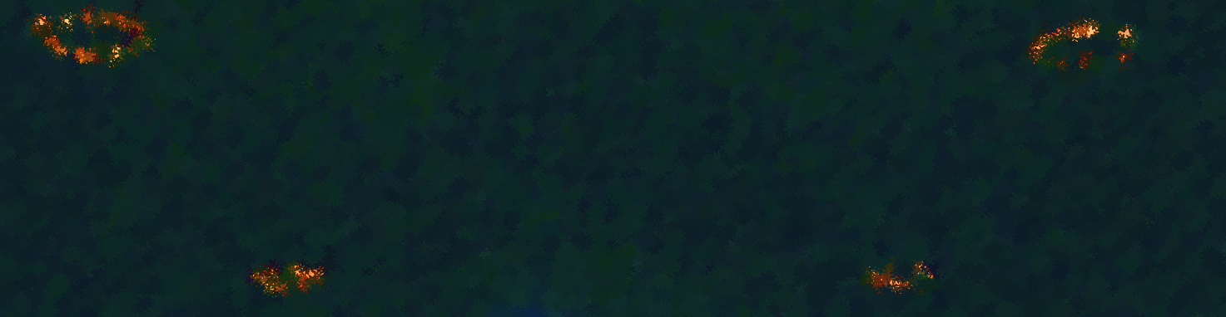

D A
Darwin
Agunos
Children's Hospital of Los Angeles Presentation
03/13/2020

Slide 2

Who am I?
I am a
recent college graduate
python programmer
scientist at heart
Notes:
recent college graduate
…who graduated with a Bachelors of Science in physics, accruing skills such as:
mathematical prowess, analytics, critical thinking skills and,
most importantly, problem-solving savviness.
python programmer
…who initially picked up programming to simulate physics phenomena
through computational methods
but transitioned to data analytics when I became a physics education researcher. (PER)
scientist at heart
…who seeks out problems to solve and build upon.
I have a series of projects using python and tableau for
both educational research and improving upon the work of others.

Slide 3
Projects
What have I done?
Student Analysis
Makeover Monday
Makeover Monday
Machine Learning
Notes:
Student Analysis
Used Python for Exploratory Data Analysis on student data to explore trends and relationships between course outcomes and prevalent features to distinguish characteristics that separate student performance. Features including, but not limited to minority status, ethnic status, instruction types, SAT Scores, etc…
Makeover Monday
Weekly social data project geared to exploring different perspectives
and approaches to create effective visualizations by re-creating visualizations
published in articles, websites and newspapers.
Machine Learning
Created the first machine learning project for the PER group at Cal Poly Pomona as a student researcher:
Random Forest Classification Model to assess student risk of failure in an introductory kinematics course
before the student takes the course

Slide 4
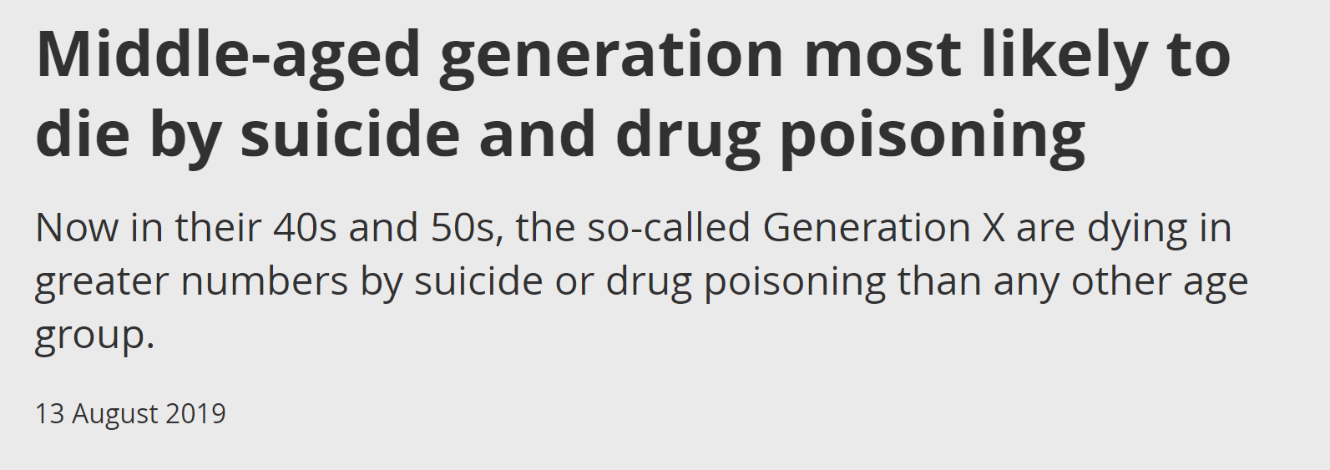
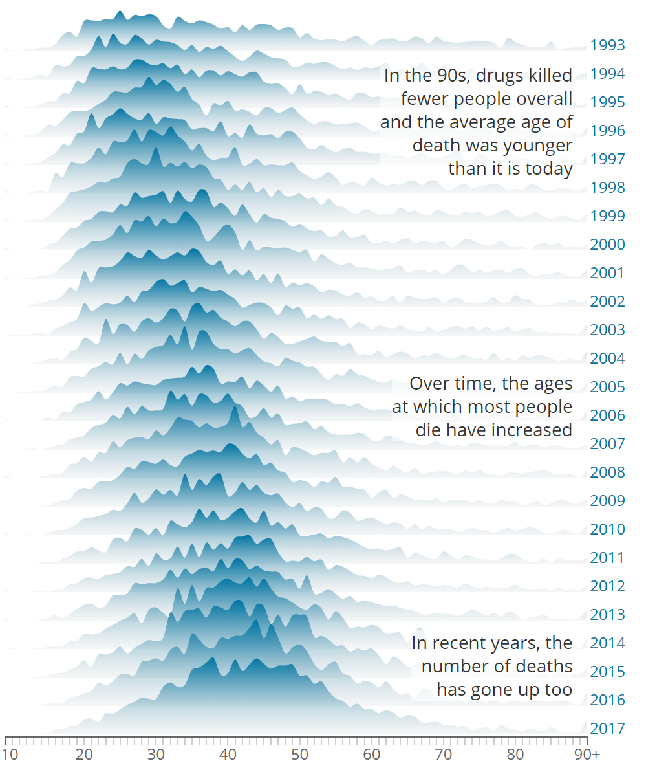
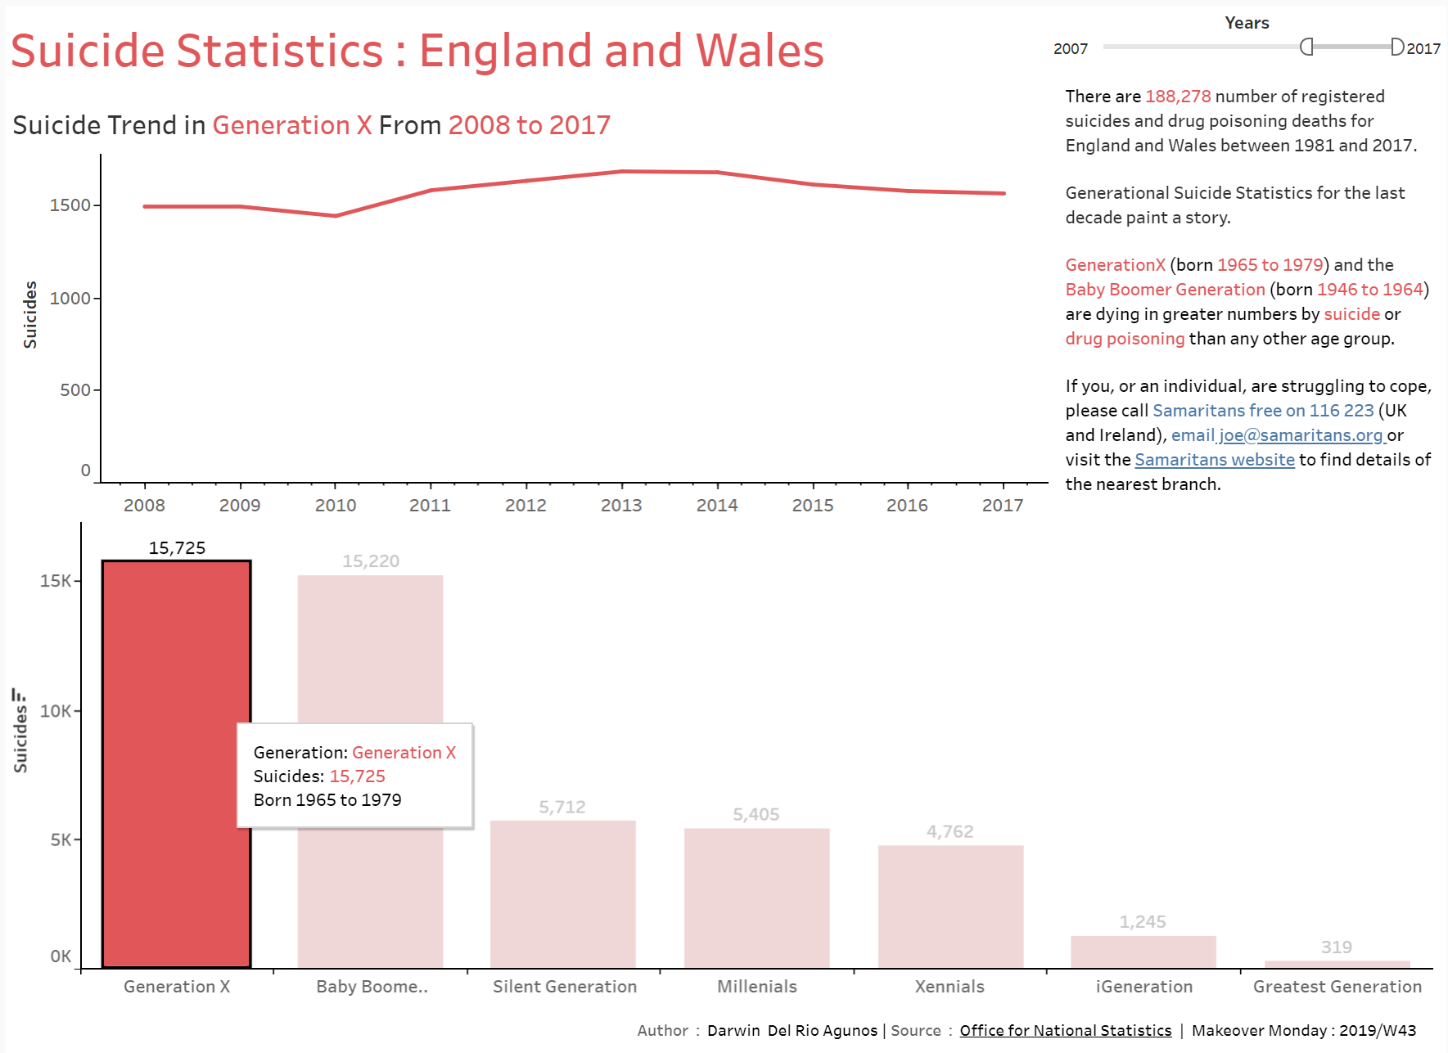
Projects
Makeover Monday
Original Visualization
Notes:
Student Analysis
Used Python for Exploratory Data Analysis on student data to explore trends and relationships between course outcomes and prevalent features to distinguish characteristics that separate student performance. Features including, but not limited to minority status, ethnic status, instruction types, SAT Scores, etc…
Makeover Monday
Weekly social data project geared to exploring different perspectives
and approaches to create effective visualizations by re-creating visualizations
published in articles, websites and newspapers.
Machine Learning
Created the first machine learning project for the PER group at Cal Poly Pomona as a student researcher:
Random Forest Classification Model to assess student risk of failure in an introductory kinematics course
before the student takes the course

Slide 5




Choosing A New Project
A Healthcare Project
Drug Discovery
Use Cases
Predictive
Analytics
Virtual
Assistance
Notes:
Left side:
With primary sources, electronic medical records (EMRs),
clinical trials, genetic information, billing, scientific articles, etc…
the healthcare industry has no shortage of data available. Here are some Data Science Use Cases
Drug Discover
Data Science and Machine Learning are revolutionizing the Pharmaceutical industries process of clinical drug trials
by providing extensive insights into optimizing and increasing the success rate of predictions.
Predictive Analytics
Research studies have been developing strategies for assisting clinicians
in decision making using machine learning techniques to extract knowledge from clinical data.
Virtual Assistance
With the help of disease predictive modeling,
data scientists have developed virtual platforms that aid to patients; such as Ada and Woebot

Slide 6



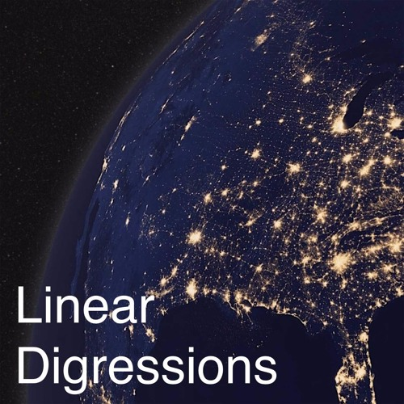

Drug Discovery
Predictive
Analytics

Slide 7
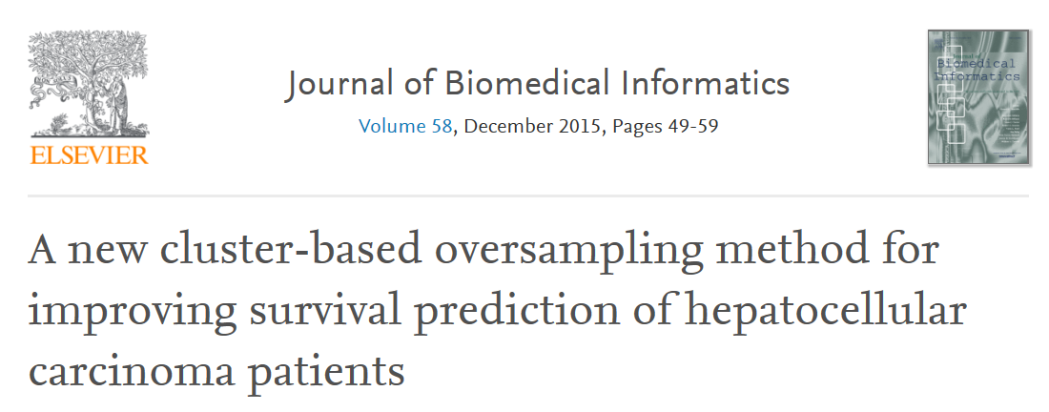
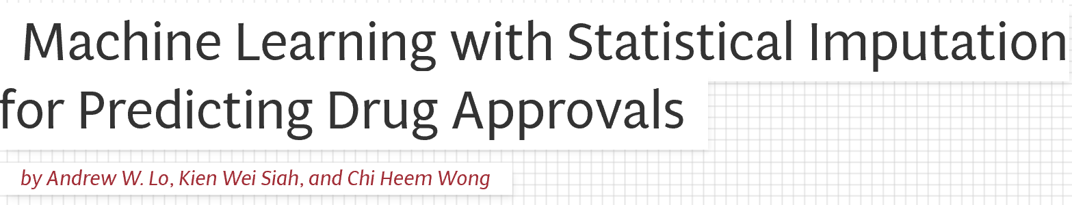
The New Project
Cluster-Based Oversampling Method for Improving Survival Prediction of Hepatocellular Carcinoma Patients - Revisited
Goal: Combine the papers like a mad scientist and to replicate and improve upon the results of the original paper

Slide 8

The New Project Timeline
March 6
March 13
February 13
Do the research
Paper
Code
PP
February 29
March 11
Chosen to
Interview
Interview Day

Slide 9
February 13
-
February 29
Predictive
Analytics
Do the research
165 Patients/49 Variables
1 Year Survival Prediction
Problems:
Heterogeneous data
MD (Missing Data)
Data Imbalance
Results: Improved Survival Predictions Using New Methodology
MD (Missing Data)
Notes:
What is hepatocellular carcinoma?
Hepatocellular Carcinoma is a liver cancer that accounts for over 90% of all liver cancer cases and is a major global health problem.
Some may say its right up there with the Coronavirus.
Now the American Cancer Society estimates in 2020 that there will be 30,000 new deaths attributed by liver cancer in the United States
30,000 new deaths and 40,000 thousand new cases. Affliction rates have tripled since the 1980s, rising 2% annually in recent years.
The fatality rate for liver cancer is over double what it was four decades ago.
With an increase in affliction and fatality rates, this is a field of healthcare that could benefit from predictive analytics.
* Bring in predictive analytics *
Data :
Data worked with was 165 Real Life Patients diagnosed with HCC collected from the Coimbra’s Hospital and Universitary Centre. Dataset comprised of 49 variables considered important to the clinician decision process and selected by the European Association for the Study of the Liver - European Organization for Research and Treatment of Cancer.
Problems:
Heterogeneous data (23 continuous, 26 categorical)
MD (10.22% of the dataset, only 8 out of the 165 patients had complete information)
Data Imbalance. 63 died, 102 survived.
Methodology later:
Results : Improved Survival Predictions over previous methodology, using new methodology.
2nd Paper:
Missing Data Techniques: (Adding more techniques to the problem)

Slide 10
Methodology
Done in MATLAB
Original Paper
Heterogeneous data
MD (Missing Data)
NN Imputation w/ HEOM Distance
Data Imbalance
SMOTE
K-Means SMOTE
Machine Learning Algorithms

Slide 11
Methodology
Previous
Previous
New
Imbalanced Data
SMOTE
K-Means SMOTE
Machine Learning Algorithms
Logistic Regression
Neural Networks
Survival Predictions
Based on Accuracy, AUC & F1-Score
new methodology performs better on Survival Prediction Models
Results

Slide 12
February 29
March 6
-
Code
Built in Python 3.7.4:
Matplotlib: 3.1.1
Pandas: 0.25.1
Numpy : 1.16.5
Scikit-learn : 0.22.1
Seaborn: 0.9.0
TensorFlow: 2.0.0
Imbalanced Learn: 0.5.0
Distython: 0.0.3

Slide 13
February 29
March 6
-
Code
Their Approach:
Heterogeneous data
HEOM
MD (Missing Data)
NN Imputation
Data Imbalance
No Sampling
SMOTE
K-Means SMOTE
Machine Learning Algorithms
Neural Network
Logistic Regression
Results: Better survival prediction results than previous methodology
Built in Python 3.7.4:
Matplotlib: 3.1.1
Pandas: 0.25.1
Numpy : 1.16.5
Scikit-learn : 0.22.1
Seaborn: 0.9.0
TensorFlow: 2.0.0
Imbalanced Learn: 0.5.0
Distython: 0.0.3

Slide 14
February 29
March 6
-
Code
My Adjustments:
MD (Missing Data)
Mean/Mode Imputation
Listwise Deletion
5NN Imputation
Data Imbalance
Undersampling
Machine Learning Algorithms
Random Forest
XGBoost
Support Vector Machine
My Results:
Their Approach:
Heterogeneous data
HEOM
MD (Missing Data)
NN Imputation
Data Imbalance
No Sampling
SMOTE
K-Means SMOTE
Machine Learning Algorithms
Neural Network
Logistic Regression
.
Built in Python 3.7.4:
Matplotlib: 3.1.1
Pandas: 0.25.1
Numpy : 1.16.5
Scikit-learn : 0.22.1
Seaborn: 0.9.0
TensorFlow: 2.0.0
Imbalanced Learn: 0.5.0
Distython: 0.0.3
Results: Better survival prediction results than previous methodology
My Results:

Slide 15
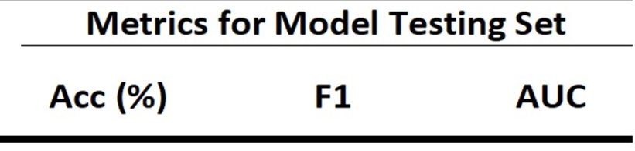
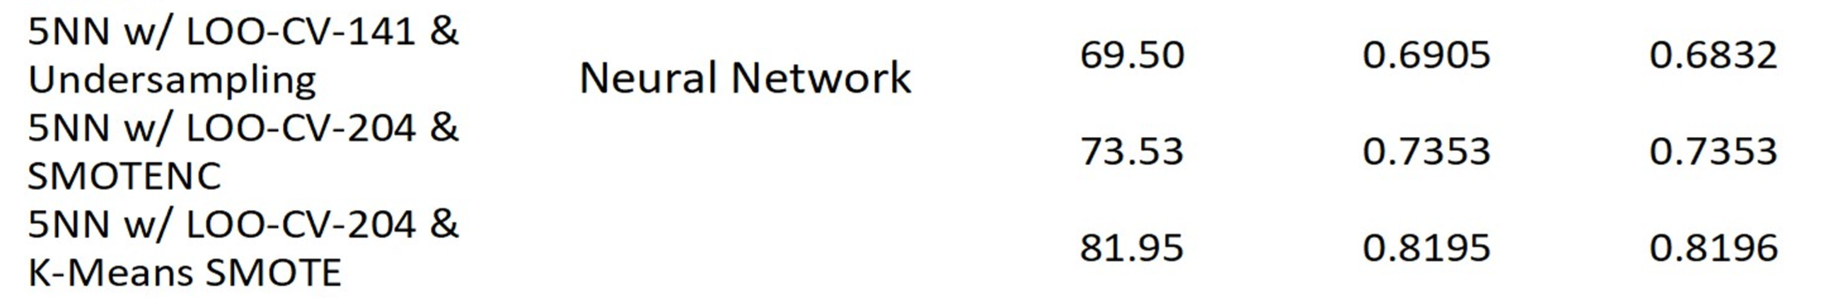
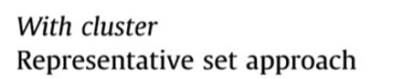
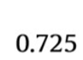
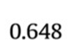
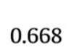
February 29
March 6
-
Code
My Results:
Results: Better survival prediction results than previous methodology
Built in Python 3.7.4:
Matplotlib: 3.1.1
Pandas: 0.25.1
Numpy : 1.16.5
Scikit-learn : 0.22.1
Seaborn: 0.9.0
TensorFlow: 2.0.0
Imbalanced Learn: 0.5.0
Distython: 0.0.3

Slide 16
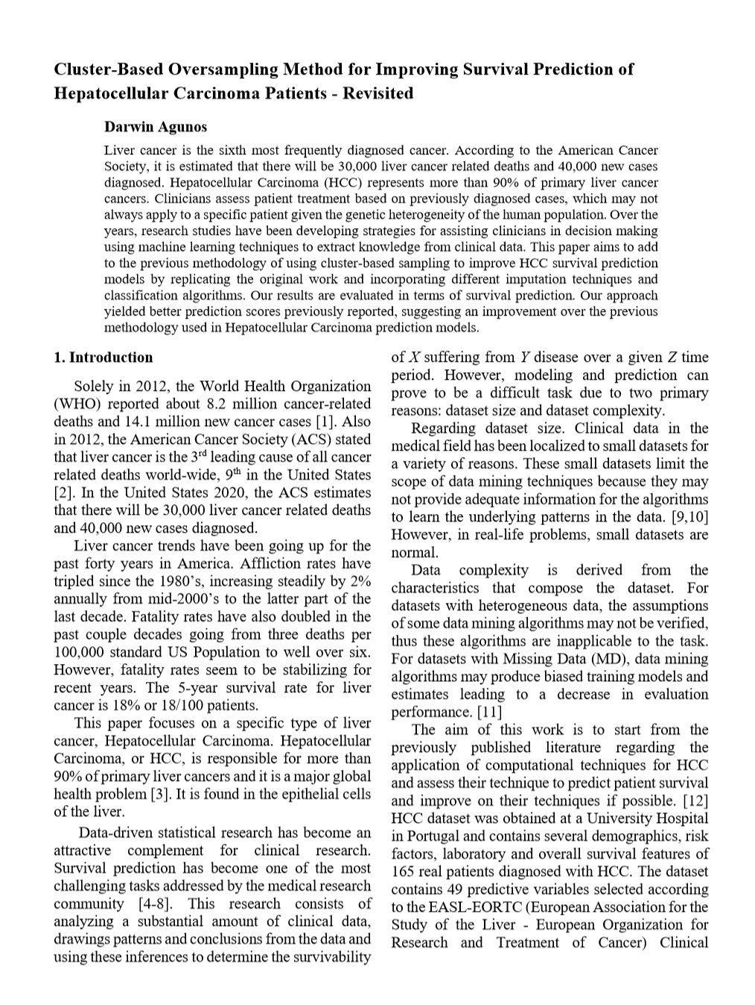
-
March 6
March 11
Paper

